Slide 1


SMART INDIA HACKATHON 2026
Problem Statement ID – SIH 26037
Problem Statement Title – Adaptive Path Planning and Collision Avoidance for Autonomous Vehicles on Unstructured Indian Roads
Theme – Robotics and Drone
PS Category – Software
Team ID – SIH120
Team Name – Eureka
• Problem Statement ID –
• Problem Statement Title-
• Theme-
• PS Category- Software/Hardware
• Team ID-
• Team Name – Eureka
• Team Name (Registered on portal)

Slide 2

Vehicle Sat-Nav Hazard Detection & Rerouting System
Your
Team Name
ehicle Sat-Nav Hazard Detection & Rerouting Syste
ehicle Sat-Nav Hazard Detection & Rerouting Syste
IDEA TITLE
EUREKA
EUREKA
EUREKA
PROPOSED SOLUTION
Proposed Solution (Describe your Idea/Solution/Prototype)
Detailed explanation of the proposed solution How it addresses the problem
Innovation and uniqueness of the solution
1 DETECT
2 ASSESS
3 REROUTE + ALERT
•
•
•
Ingest weather, terrain/DEM, satellite and on-road perception data.
Analyse a 10–20 km route corridor using H3 tiles.
GBMs score landslide, flood and avalanche risk.
CNN handles glacier/GLOF imagery and obstacle/lane perception.
Fuse probability, severity, exposure and confidence; hysteresis filters noise.
OSRM/Valhalla treats fused risk as an edge-weight penalty.
Reroute only after threshold + hysteresis confirm a real transition.
Local LLM produces schema-constrained JSON alerts only.
Innovation: routing remains deterministic; the gated LLM only explains confirmed state changes. Connectivity loss triggers last-known risk + static terrain/obstacle fallback.

Slide 3
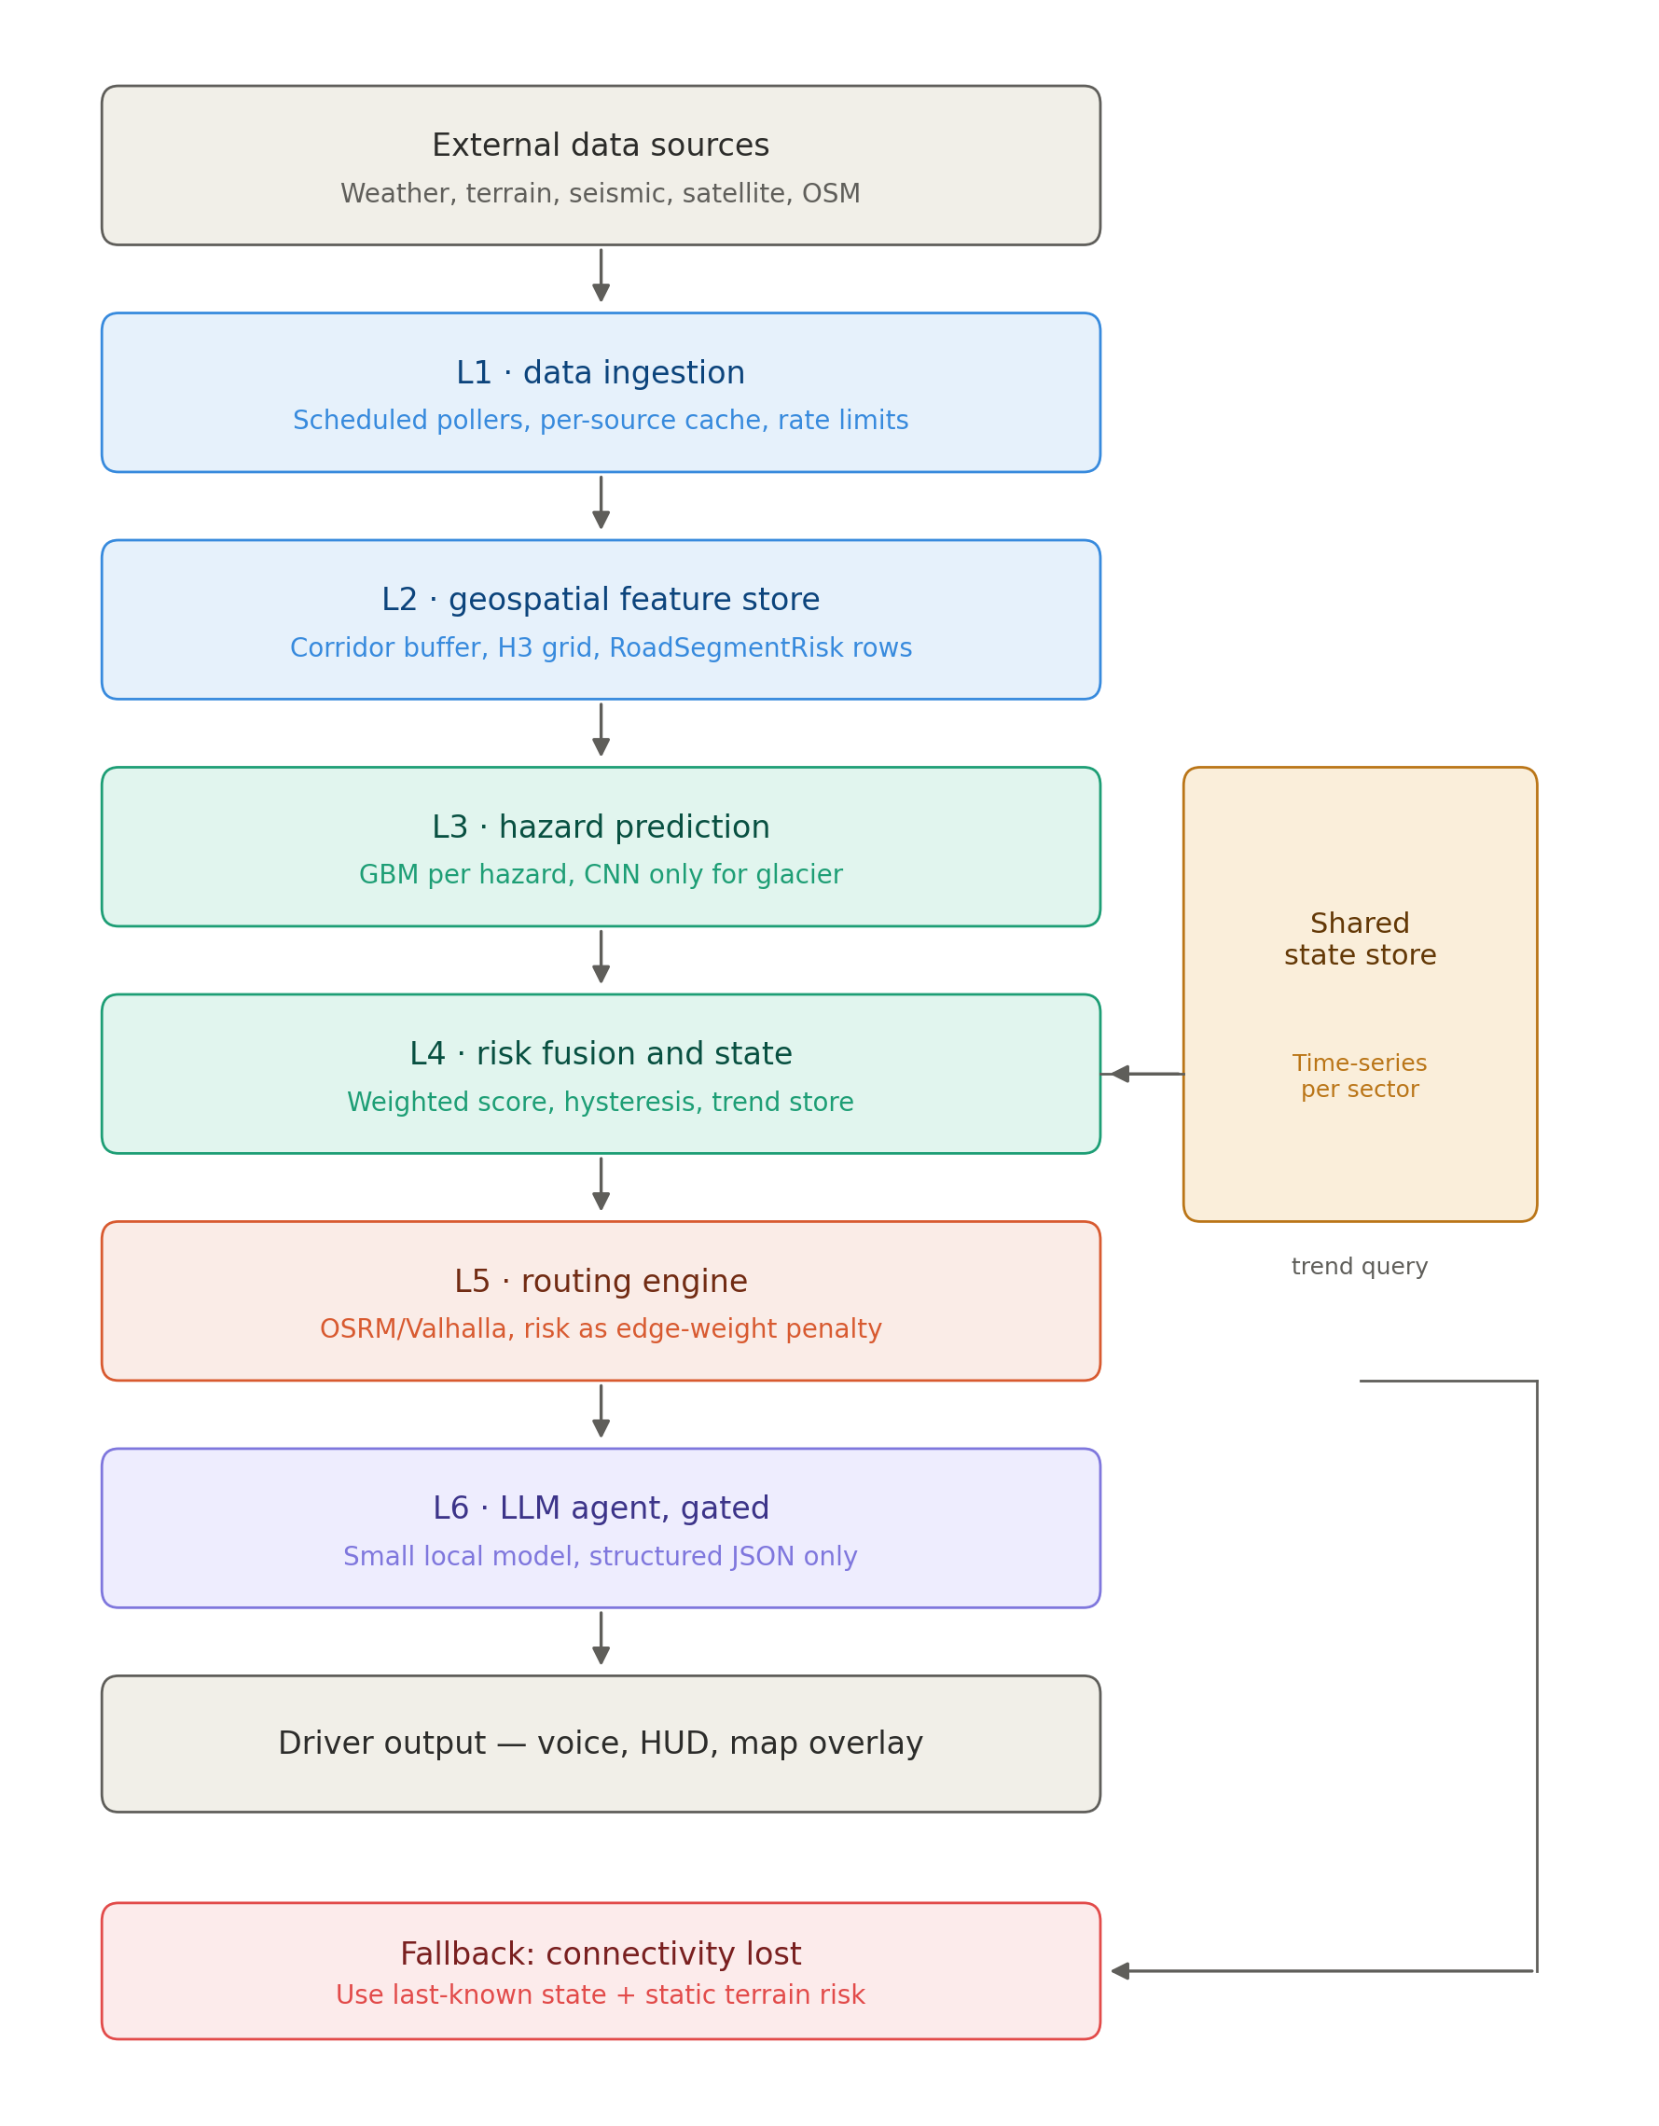
Vehicle Sat-Nav Hazard Detection & Rerouting System
Youeam Name
TECHNICAL APPROACH
Vehicle Sat-Nav Hazard Detection & Rerouting System
Vehicle Sat-Nav Hazard Detection & Rerouting System
EUREKA
EUREKA
EUREKA
TECHNOLOGY STACK
Android mobile / in-vehicle client
OSRM or Valhalla + OpenStreetMap
H3 + RoadSegmentRisk geospatial store
XGBoost/LightGBM GBMs; CNN for glacier/GLOF
Shared time-series risk state
Local 3–8B quantized LLM (e.g., Ollama), JSON-only
• Technologies to be used (e.g. programming languages,
frameworks, hardware)
• Methodology and process for implementation (Flow Charts/Images/ working prototype)
IMPLEMENTATION METHOD
1. Routing core + corridor/H3 tiling
2. Landslide GBM end-to-end pipeline
3. Risk fusion + hysteresis state
4. Risk-weighted alternate routing
5. Gated local LLM + structured JSON
6. Flood, avalanche, glacier CNN + offline fallback

Slide 4
FEASIBILITY AND VIABILITY
F FEASIBILITY AND VIABILITY
EASIBILITY AND VIABILITY
FEASIBILITY AND VIABILITY
Name
EUREKA
EUREKA
EUREKA
FEASIBLE
CHALLENGES
MITIGATION
• Analysis of the feasibility of the idea
• Potential challenges and risks
• Strategies for overcoming these challenges
OpenStreetMap + OSRM/Valhalla provide an accessible routing base.
GBMs support millisecond inference with smaller labelled datasets.
Scope is bounded to a 10–20 km corridor.
API rate limits and data availability.
Noisy readings may cause false reroutes.
Connectivity loss and slow satellite revisit.
Aggressive caching + scheduled polling.
Threshold + hysteresis before rerouting.
Last-known-state fallback; async glacier CNN.
Test every phase on a real route.
SCOPE CONTROL
Full Level 4/5 autonomous control and heavier Physics-GNN / ConvLSTM+ResNet models are deferred from the SIH MVP.

Slide 5
IMPACT AND BENEFITS
Your
Team Name
IMPACT AND BENEFITS
IMPACT AND BENEFITS
IMPACT AND BENEFITS
EUREKA
EUREKA
EUREKA
TARGET USERS
BENEFITS
• Potential impact on the target audience
• Benefits of the solution (social, economic, environmental, etc.)
Drivers / travellers: route maps, hazard overlays and reroute alerts via a low-distraction interface.
Local authority / disaster-management officials: aggregated hazard and road-condition review in future dashboard work.
Administrators: data-source, threshold and retraining configuration.
Reduces risk exposure by adapting routes around flagged segments.
Supports collision avoidance for dynamic obstacles and unmarked lane conditions.
Concise structured alerts instead of raw model output.
Warnings persist during connectivity loss via last-known + static risk.
Lightweight design limits compute and LLM use to meaningful transitions.
Prototype scope: decision support and alerts; no assumption of full vehicle actuation control.

Slide 6
RESEARCH AND REFERENCES
Your
Team Name
RESEARCH AND REFERENCES
RESEARCH AND REFERENCES
RESEARCH AND REFERENCES
EUREKA
EUREKA
EUREKA
REFERENCE BASE
Smart India Hackathon 2026 problem statement documentation — SIH 26037.
IEEE Std 830-1998 — Recommended Practice for Software Requirements Specifications.
Team architecture design — six-layer architecture, UML class model, runtime flow and execution plan.
DESIGN EVIDENCE
  Six ordered layers from data ingestion to driver output.
  Shared time-series state supports rising/falling risk trends.
  Routing remains a graph-search responsibility; LLM is gated and JSON-only.
  Offline fallback prevents connectivity loss from becoming a false 'no warning' state.
Content source: supplied SRS + architecture documents. Layout: supplied SIH 2026 presentation template.
• Details / Links of the reference and research work

